Slide 1
General announcements

Slide 2
Momentum and Energy
We know momentum is conserved in collisions as long as there are no external impulses or the external forces being applied over the time interval of the collision are deemed small (the force a wall would apply to a ball as the ball hit the wall wouldn’t qualify).
What about energy?
  In most cases, potential energy changes during collisions are negligible because the change in position of the pieces through the collision are miniscule.
  In most collisions, at least one object is moving before the collision, so there is some amount of kinetic energy. (An “explosion” is a reverse collision, and the objects begin with zero KE)
  During the collision, energy is usually transferred into other forms.
    Sound energy, internal energy (remember, internal energy is related to temp…), and work to deform the objects (e.g. car crash)
Collision types are:

Slide 3
Elastic collisions (both KE and momentum conserved)
(Mythical in the sense that you have to be told to assume this is true.)
Inelastic collisions (momentum conserved extra info needed for KE)
(THIS IS THE NORM where energy is not conserved but momentum is.)
Perfectly Inelastic collisions (momentum conserved with bodies becoming one and final velocities same)
(A normal, inelastic collision in which the TWO BODIES STICK TOGETHER.)

Slide 4
Collision example – problem 6.25
An astronaut in her space suit has a total mass of 87.0 kg, including suit and oxygen tank. Her tether line loses its attachment to her spacecraft while she's on a spacewalk. Initially at rest with respect to her spacecraft, she throws her 12.0-kg oxygen tank away from her spacecraft with a speed of 8.00 m/s to propel herself back toward it. (Alternative: the ice pond problem.)
  (a) Determine the maximum distance she can be from the craft and still return within 2.00 min (the amount of time the air in her helmet remains breathable).
  (b) Explain in terms of Newton's laws of motion why this strategy works.

Slide 5
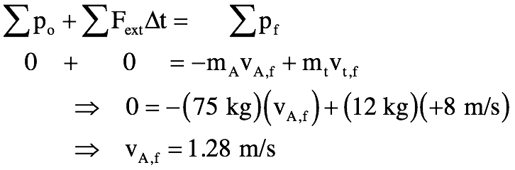
Problem 6.25 (cont’d.)
(a) Determine max distance in order to return in 2 min.
The total momentum in the system to start with is zero, so that has to be the net, total momentum of the system throughout time (there are no external impulses acting to change the total momentum). As such, we can write:
Traveling at 1.28 m/s for 120 seconds (2 minutes) means she can travel a distance of:

Slide 6
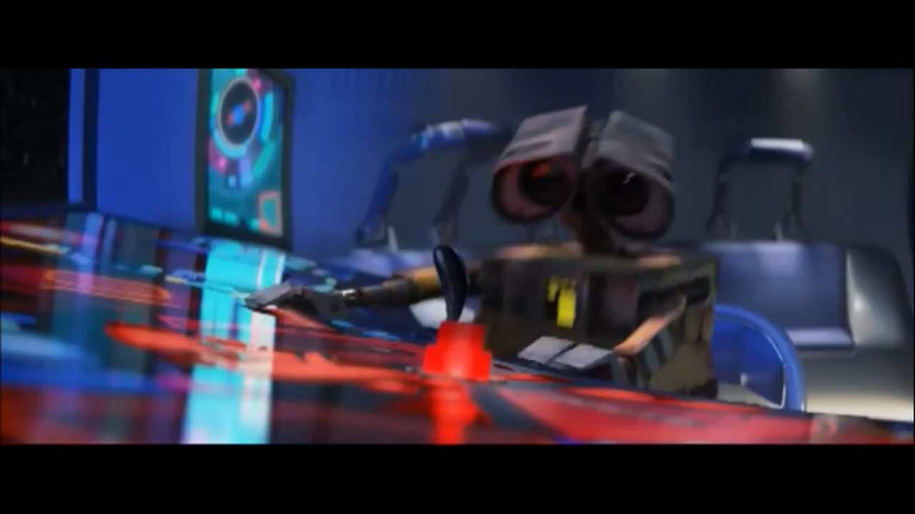
(b) Explain using Newton’s Laws
She applies a force to the tank that accelerates it to the right while it applies an equal and opposite force on her that accelerates her to the left. The forces are the same, but as the masses are different, the accelerations will be different and will be governed by F=ma.
You’ve (probably) seen something like this in a movie…

Slide 7
Speaking of space and astronauts…
Three astronauts are hanging out in space and are bored out of their minds. They decide to play a game of “catch.” Astronaut 1, who is right next to Astronaut 2, grabs 2 and shoves him with velocity v towards Astronaut 3, who is a little distance away. Astronaut 3 catches 2, and then she shoves him back towards Astronaut 1. Assuming all three have roughly the same mass and the same pushing strength, how many “throws” will there be in the game?
3
2
1

Slide 8
Spring-gun explosion
A spring-gun of mass m_{g} = 2 kg uses an ideal spring with k = 120 N/m to shoot a ball of mass m_{b} = 0.04 kg out of its barrel. At a particular moment in time, the cocked gun and ball are moving backwards over a frictionless table with velocity v₀ = 5 m/s (the word backwards means when the gun is fired the bullet will move in the opposite direction of the gun’s motion). Relative to the table, what will the gun’s velocity (v_{g}) and the ball’s velocity (v_{b}) be just after firing? Assume the spring is compressed a distance x = 0.15 m when the gun is cocked.
0.15 m
v₀ = 5 m/s
  Where is energy conserved?
  Where is energy not conserved?
  Where is momentum conserved?
  Where is momentum not conserved?
x = 0

Slide 9




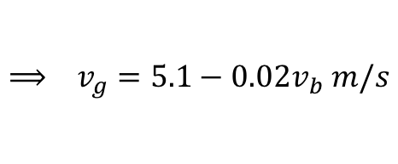
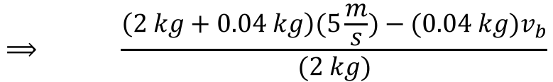
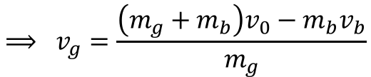
Spring-gun explosion
We know momentum is conserved before and after the “explosion.” So we can write:
$$Σp_{i}+ΣFΔt=Σp_{f}$$
$$m_{g}v_{0}+m_{b}v_{0}=m_{g}v_{g}−m_{b}v_{b}$$
$$⟹ v_{g}=\frac{\left(m_{g}+m_{b}\right)v_{0}−m_{b}v_{b}}{m_{g}}$$
$$⟹ \frac{\left(2 kg+0.04 kg\right)(5\frac{m}{s})−(0.04 kg)v_{b}}{(2 kg)}$$
$$⟹ v_{g}=5.1−0.02v_{b} m/s$$
We can also use Conservation of Energy through the firing, because the spring is ideal:
0
0
$$ΣK_{i}+ΣU_{i}+ΣW_{ext}=ΣK_{f}+ΣU_{f}$$
$$\frac{1}{2}\left(m_{b}+m_{g}\right)v_{0}^{2}+\frac{1}{2}kx^{2}=\frac{1}{2}m_{g}v_{g}^{2}+\frac{1}{2}m_{b}v_{b}^{2}$$

Slide 10

Spring-gun explosion
Substituting the expression for v_{g} into the energy equation yields:
$$\frac{1}{2}\left(m_{b}+m_{g}\right)v_{0}^{2}+\frac{1}{2}kx^{2}=\frac{1}{2}m_{g}{(5.1−0.02v_{b})}^{2}+\frac{1}{2}m_{b}v_{b}^{2}$$
Plugging in numbers yields the following (after some algebra):
$$0=0.0204v_{b}^{2}−0.204v_{b}−0.84$$
Quadratic formula yields two answers: v_{b} = 13.13 m/s or -3.13 m/s.
Which one is it?
First, we know the bullet has to go opposite the direction the gun was going before. Because we made v₀ +5m/s in the momentum equation, v_{b} must be negative.
Second, if we plug both options into the expression for v_{g}, we get 4.8 m/s or 5.16 m/s respectively. The gun must be going faster in its original direction after the explosion (Think about it) so the bullet v_{b} = -3.13 m/s (- meaning opposite direction from the gun) and gun v_{g} = 5.16 m/s.

Slide 11
Take the extended ice dome problem and make it into a Jack and Jill event with Jill shoved up against a spring (not shown) to start with and Jill crashing into Jack at the crest of the hill. Now you need to work in sections, keeping in mind where energy and where momentum are conserved (and where they aren’t!).
Jill starts
here against spring
Jill and
Jack collide
two leave
The next page animates this segregating:
41.)

Slide 12
after collision energy conserved
Jill’s velocity just before collision
Jill and Jack’s velocity just after collision
before collision, energy conserved
still need Newton’s Second and centripetal acceleration
during collision, momentum conserved
42.)

Slide 13
There is the problem from hell with the first mass running into a second mass in a perfectly inelastic collision.
In that case, you’d have to use energy up until the collision, then momentum to connect the before collision and after collision velocities, then go from there with energy considerations.
43.)

Slide 14
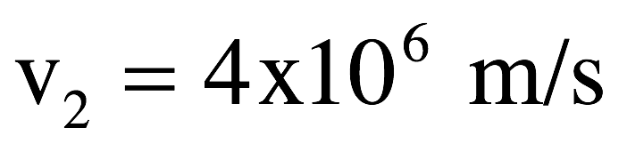
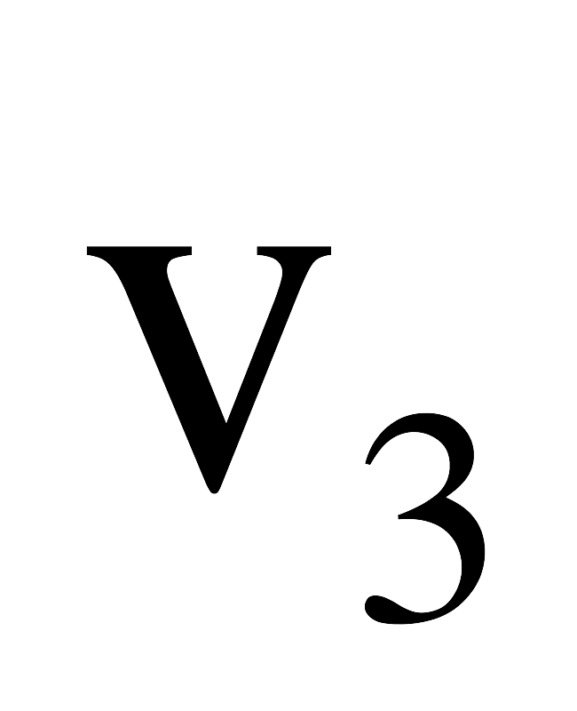

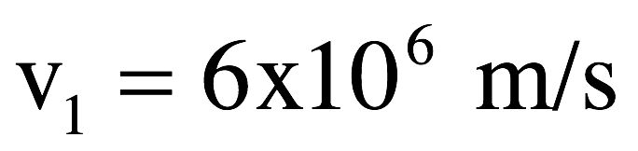
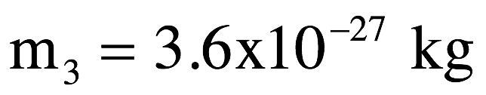
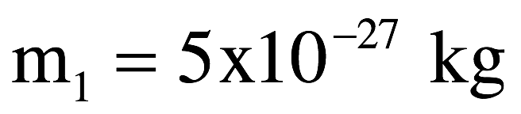
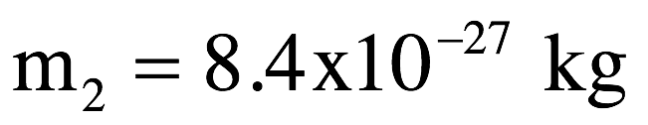
Classic explosion problem (6.60)
A nucleus decays ejecting three particles. Two have known velocity and direction. The third has unknown velocity and direction. Determine the unknown quantities.
See solution on class Website.

Slide 15
How about a little different angle:
Let’s assume the entire mass is moving with an initial velocity of in the x-direction. If body 3’s angle is , what is the final velocity of body 1 and 3?

